Slide 1
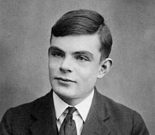
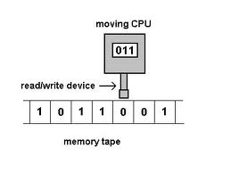
Turing Machine Examples
Instructor: Dr. Sohail Iqbal
Book: Prof. Sipser-MIT
Slides: Prof. BUSCH-LSU

Slide 2
Recap: Turing Machine: A Global View
A device that manipulates symbols on a strip of tape following certain rules
It can be adapted to simulate the logic of any computer algorithm
It is useful in explaining the functions of a CPU inside a computer

Slide 3
Recap: Example of Turing Machine
Turing machine for the language

Slide 4
Formal Definitions for Turing Machines

Slide 5
Transition Function
Write
Read
Head

Slide 6
Transition Function

Slide 7
Following the old pattern of
Deterministic Finite Automaton (DFA)
: set of states
: input alphabet
: transition function
: initial state
: set of accepting states

Slide 8
Turing Machine: Formally, it’s a 7-tuple
Input
alphabet
Tape
States
Transition
function
Accept
states
Initial
state
blank

Slide 9
Configuration
Instantaneous description:
Notes:
An NFA is 5-tuple whereas a Turing machine is 7-tuple.

Slide 10
Time 4
Time 5
A Move:
(yields in one mode)

Slide 11
Time 4
Time 5
Time 6
Time 7
A computation

Slide 12
Equivalent notation:

Slide 13
Initial configuration:
Input string

Slide 14
The Accepted Language
For any Turing Machine
Initial state
Accept state

Slide 15
If a language is accepted
by a Turing machine
then we say that is:
Turing Recognizable
Other names used:
Turing Acceptable
Recursively Enumerable

Slide 16
Computing Functions with Turing Machines

Slide 17
A function
has:
Domain:
Result Region:

Slide 18
A function may have many parameters:
Example:
Addition function

Slide 19
Integer Domain
Decimal:
5
Binary:
101
Unary:
11111
We prefer unary representation:
easier to manipulate with Turing machines

Slide 20
Definition:
A function is computable if
there is a Turing Machine such that:
Initial configuration
Final configuration
initial state
accept state
For all
Domain

Slide 21
In other words:
A function is computable if
there is a Turing Machine such that:
Initial
Configuration
Final
Configuration
For all
Domain

Slide 22
Example
The function
is computable
are integers
Turing Machine:
Input string:
unary
Output string:
unary

Slide 23
Start
initial state
The 0 is the delimiter that
separates the two numbers

Slide 24
Start
initial state
Finish
final state

Slide 25
The 0 here helps when we use
the result for other operations
Finish
final state

Slide 26
Turing machine for function

Slide 27
Execution Example:
Time 0
(=2)
(=2)
Final Result

Slide 28
Time 0

Slide 29
Time 1

Slide 30
Time 2

Slide 31
Time 3

Slide 32
Time 4

Slide 33
Time 5

Slide 34
Time 6

Slide 35
Time 7

Slide 36
Time 8

Slide 37
Time 9

Slide 38
Time 10

Slide 39
Time 11

Slide 40
Time 12
HALT & accept

Slide 41
Another Example
The function
is computable
is integer
Turing Machine:
Input string:
unary
Output string:
unary

Slide 42
Start
initial state
Finish
accept state

Slide 43
Turing Machine Pseudocode for
Replace every 1 with $
Repeat:
Find rightmost $, replace it with 1
Go to right end, insert 1
Until no more $ remain

Slide 44
Turing Machine for

Slide 45
Example
Start
Finish

Slide 46
Another Example
if
The function
is computable
if
Input:
Output:
or

Slide 47
Turing Machine Pseudocode:
Repeat
Match a 1 from with a 1 from
Until all of or is matched
If a 1 from is not matched
erase tape, write 1
else
erase tape, write 0

Slide 48
Combining Turing Machines

Slide 49
Block Diagram
Turing
Machine
input
output

Slide 50
Example:
if
if
Adder
Comparator
Eraser

Slide 51
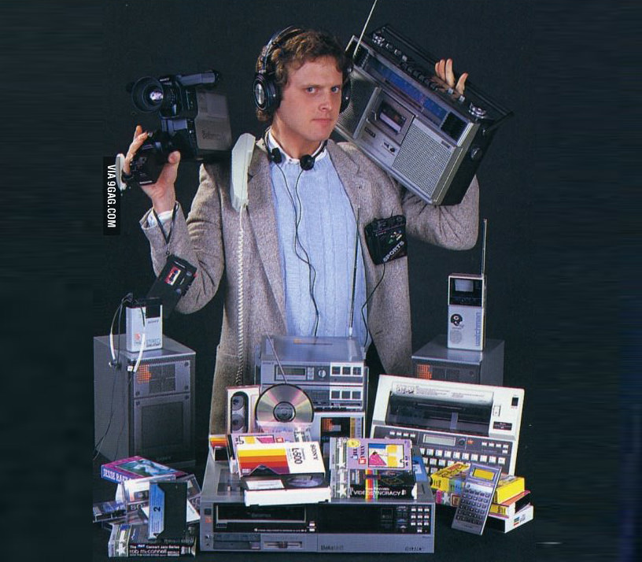

Interesting Note
A TM in your pocket (smart phone) has replaced many feature devices:
Modern TM

Slide 52
Summary
TM is a device that manipulates symbols on a strip of tape following rules
TM is a mathematical Model for computer
TM simulates any computable function
We have made an adder using TM

Slide 53
Find more about Turing Machines
Reading: Section 3.1 from Sipser’s book
https://en.wikipedia.org/wiki/Turing_machine
Thank You!

